Slide 1
第一次组会
汇报人：耿兆楣

Slide 2
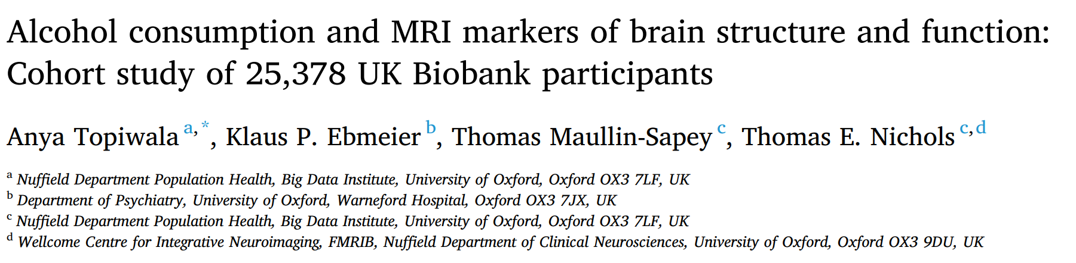
饮酒和大脑结构和功能的MRI标记：25378名UK Biobank参与者的队列研究

Slide 3
Four main research questions:
1) Are previous associations between alcohol consumption and structural neuroimaging indices reproducible in voxel-wise analyses, androbust to observed confounding? 饮酒和结构神经成像指数之间先前的关联在体素分析中是否可重复，从男性到观察到的混杂？ 2) Does alcohol consumption associate with functional connectivity in the brain?饮酒与大脑的功能连接有关吗？ 3) Do the following factors increase risk of alcohol-related brain effects: ApoE4, hypertension, high body mass index, beer and spirit consumption, and binge drinking? 以下因素是否会增加酒精相关大脑影响的风险：ApoE4、高血压、高体重指数、啤酒和烈酒消费以及酗酒？ 4) How robust are associations between alcohol and MRI markers tounobserved confounding? 酒精和核磁共振成像标记物之间的相关性有多强？

Slide 4
Variables of interest were included as potential confounders because of associations with neuroimaging measures:
age at scanning and sex
smoking status (reported in categories:never/previous/current)
educational qualifications
systolic (SBP) 收缩压and diastolic (DBP) 舒张压blood pressure
Body mass index (BMI)
Townsend Deprivation Index汤森剥夺指数
weekly exercise expenditure
diabetes mellitus diagnoses
depression cases

Slide 5
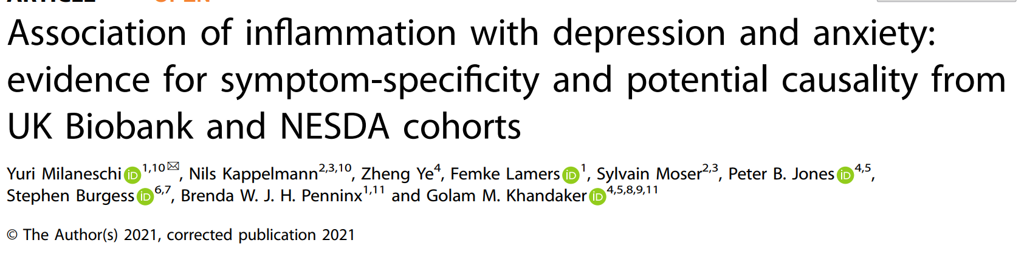
炎症与抑郁和焦虑的关系：症状特异性和潜在因果关系的来自UK Biobank和NESDA cohorts的证据

Slide 6
Covariates
age
sex
socioeconomic status (SES)（measured via the Townsend Deprivation Index ）
smoking (current/former/never)
quantity of alcohol consumption
type and time spent in physical activity
lifetime history of type two diabetes (T2D)
cardiovascular diseases(CVD)
body mass index (BMI)

Slide 7
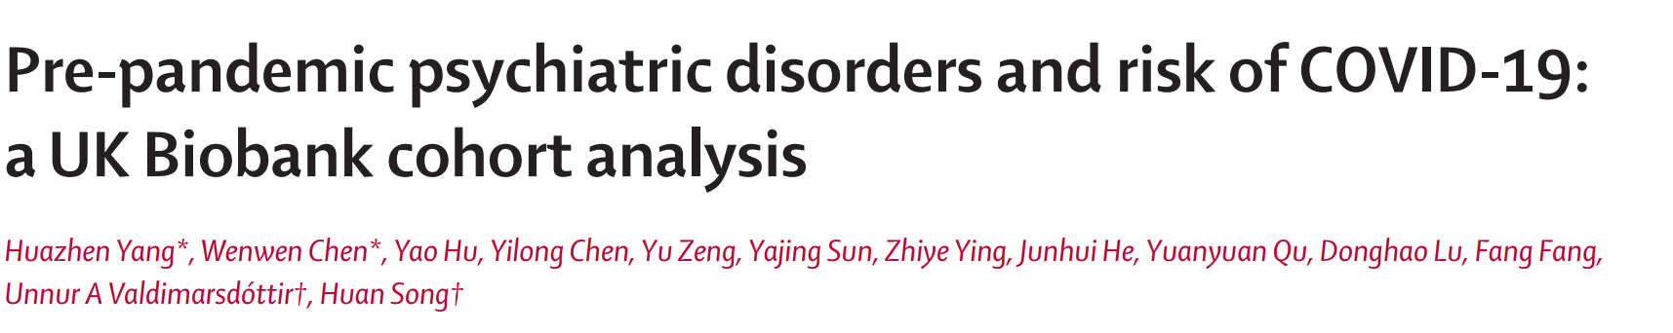
流行前精神障碍与新冠肺炎风险： UK Biobank队列分析

Slide 8
Covariates
sociodemographic characteristics (birth year, sex, and race or ethnicity)
socioeconomic factors (Townsend deprivation index, educational attainment, and annual household income)
lifestyle factors (smoking status)
Bodymass index (BMI)
Townsend deprivation index
history of somatic diseases that could affect COVID-19 susceptibility or course

Slide 9
UK Biobank : Data Dictionary for Application 68640
UK Biobank : Data Dictionary for Application 68640
UDI - the Unique Data Identifier for an item of data within the UK Biobank repository.
Count - the number of non-empty rows present in this dataset.

Slide 10
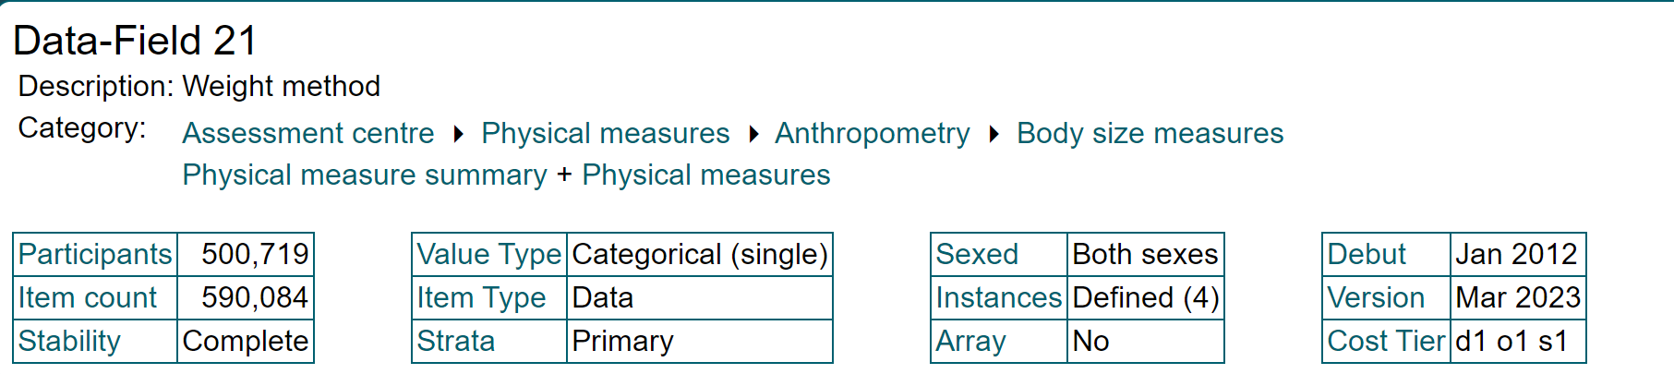
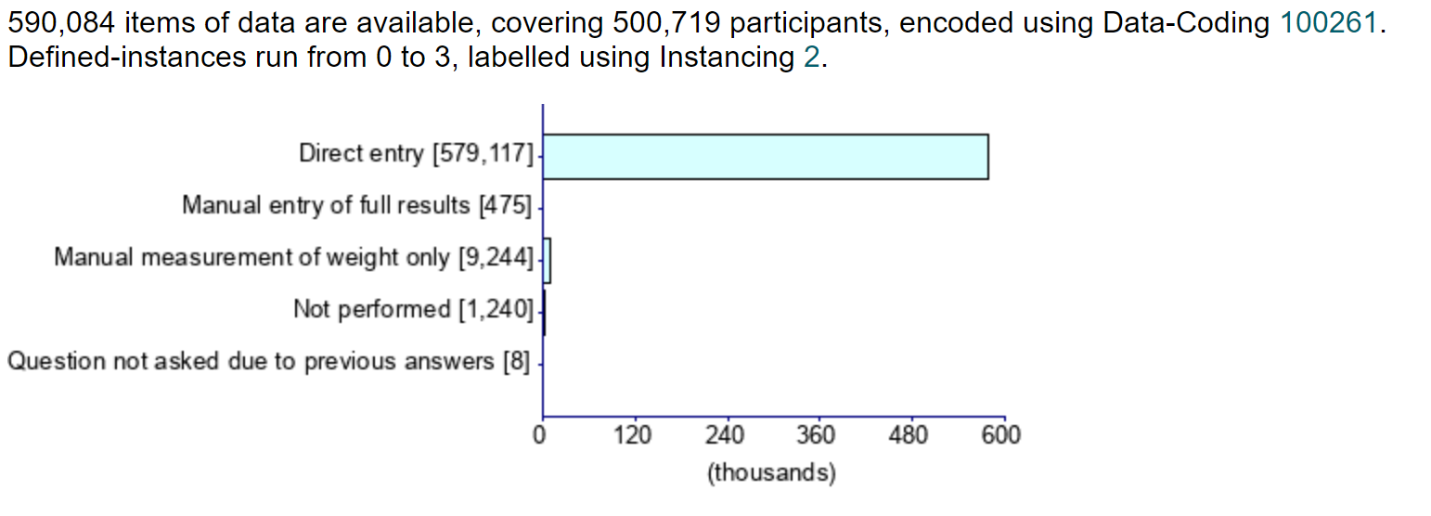
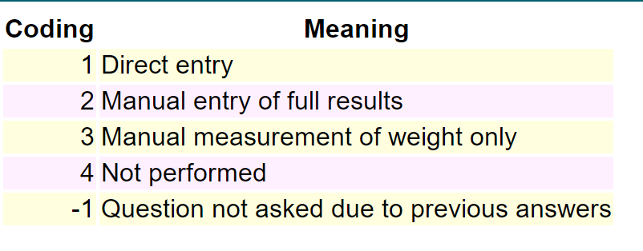
Weight method
Indicates whether weight was entered into the machine directly or manually, whether weight was only measured manually or not performed

Slide 11
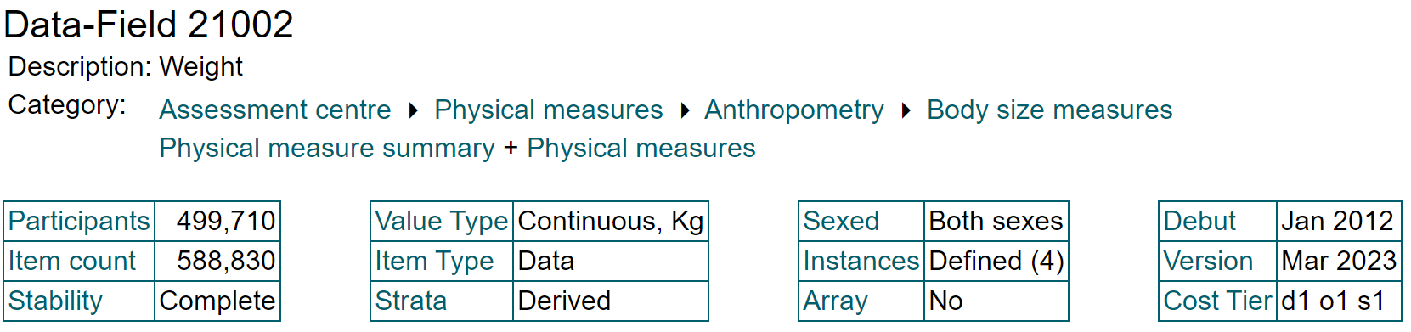
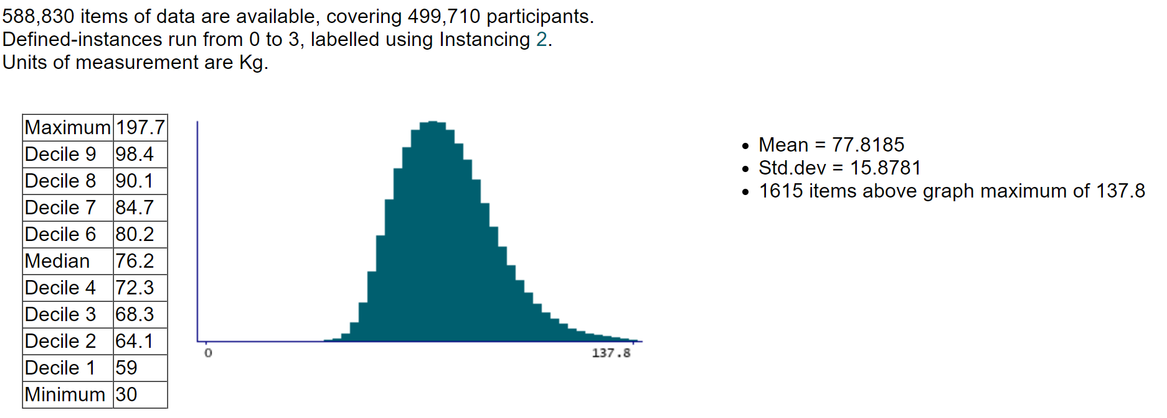
Weight

Slide 12
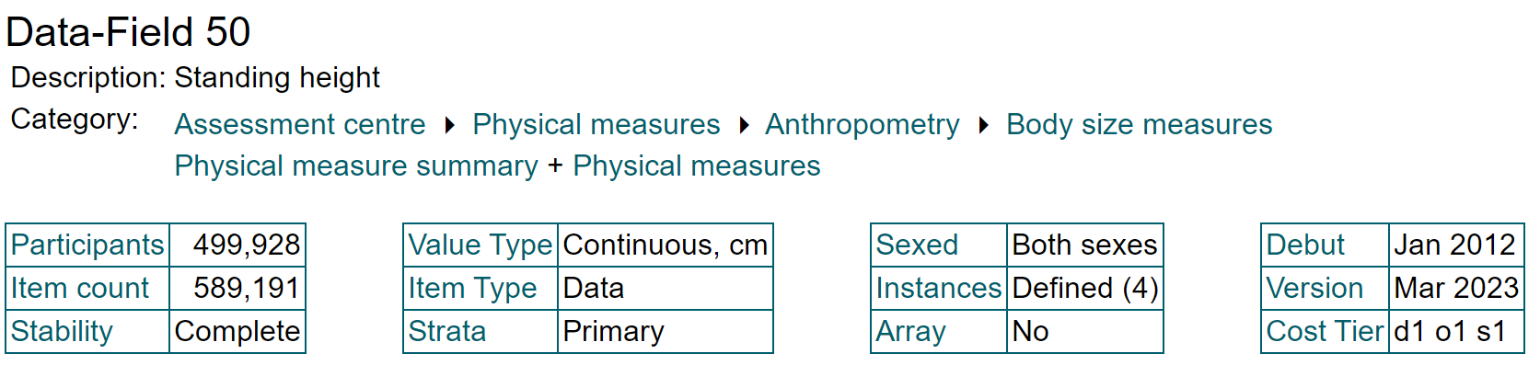
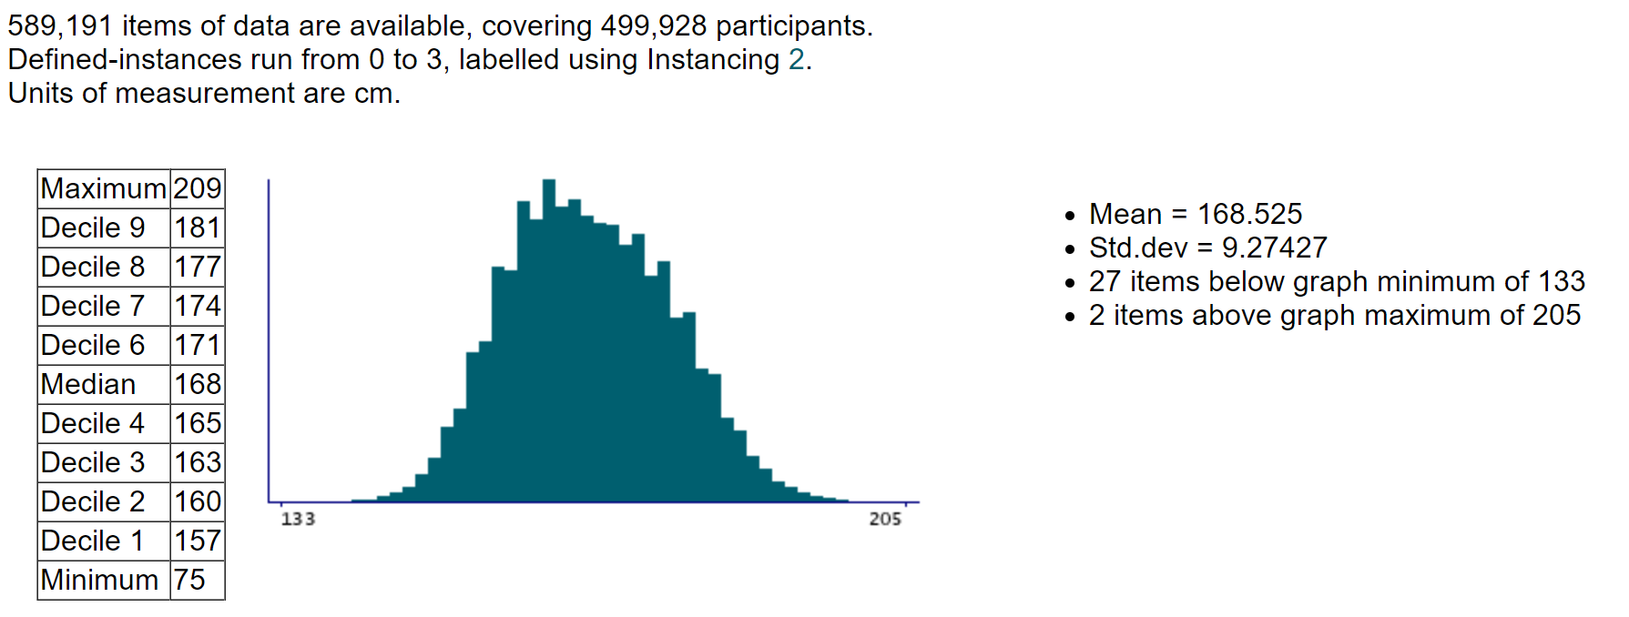
Standing height
Standing height was measured using a Seca 202 device

Slide 13
Standing height
Resource 100141
Resource 100142
Name: Height measurement
Size: 1,226,740
MD5: 16b3bac05a9d4d0f4bf450099ee2b029
Participant having standing height measured
Name: Height positioning
Size: 1,540,449
MD5: 508f13c90736694192f202d1324ee58d
Participant being put into correct position for height measurement

Slide 14
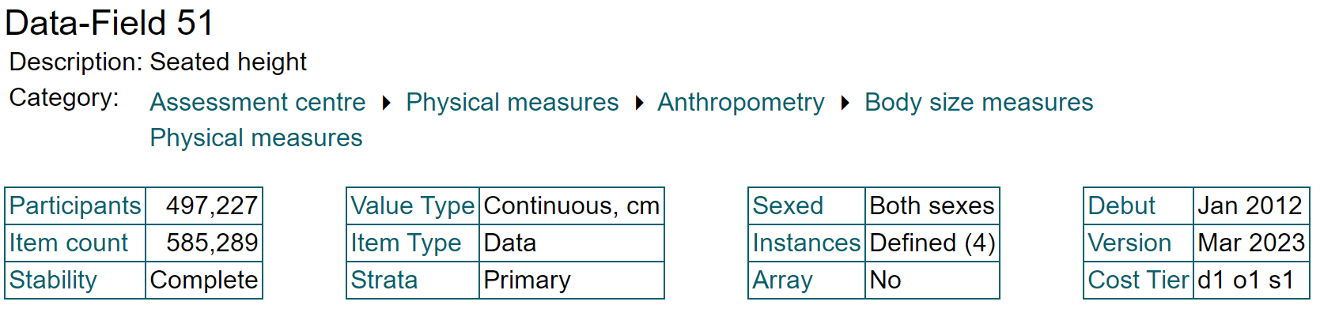
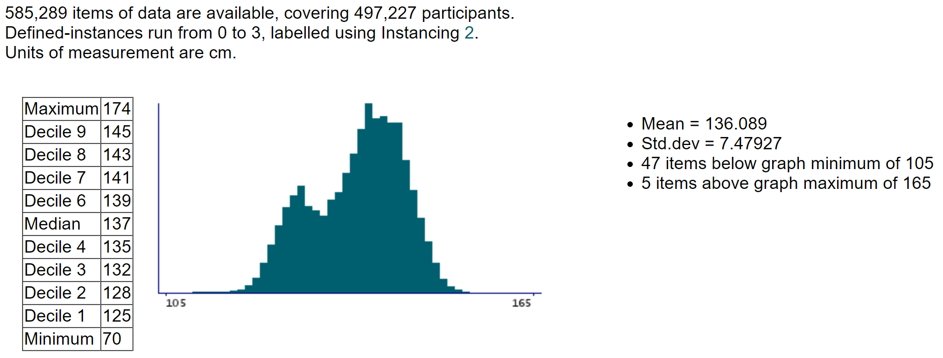
Seated height

Slide 15
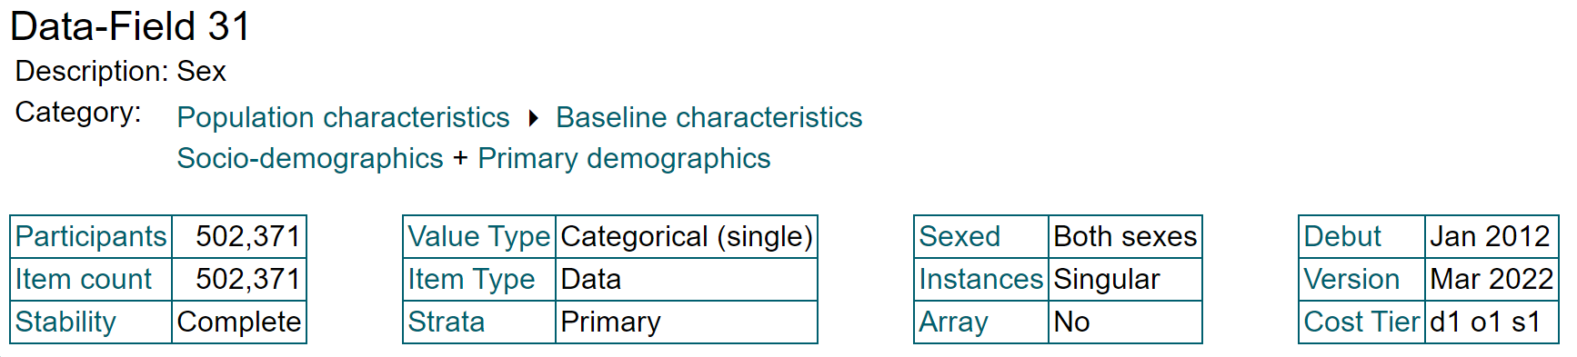
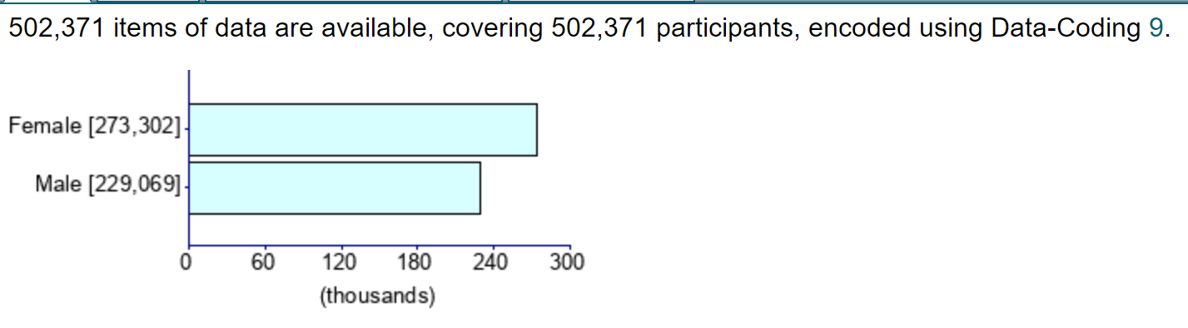
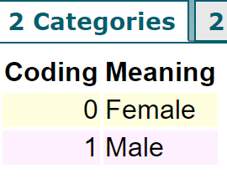
Sex

Slide 16
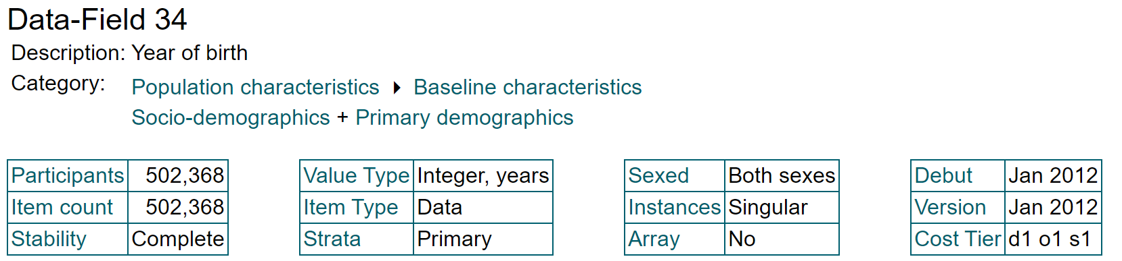
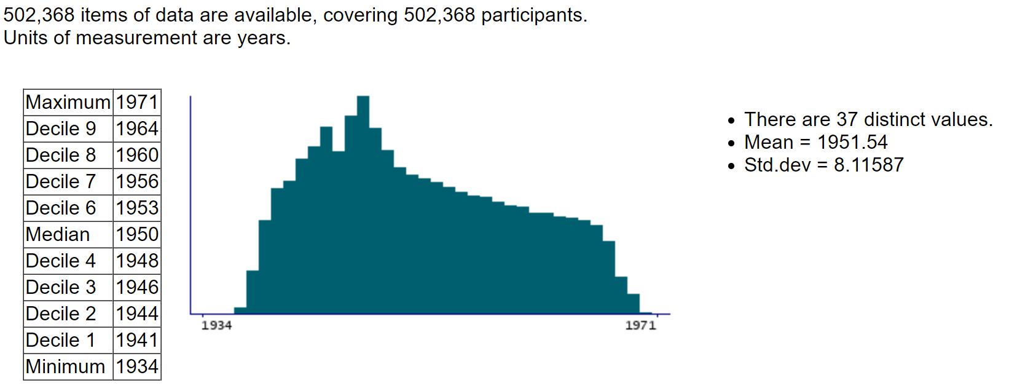
Year of birth

Slide 17
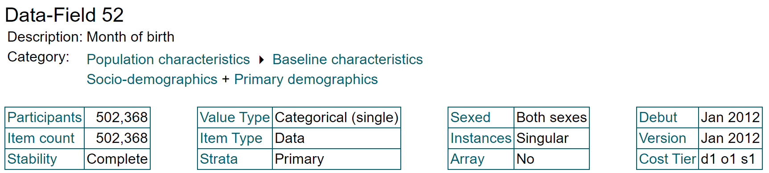
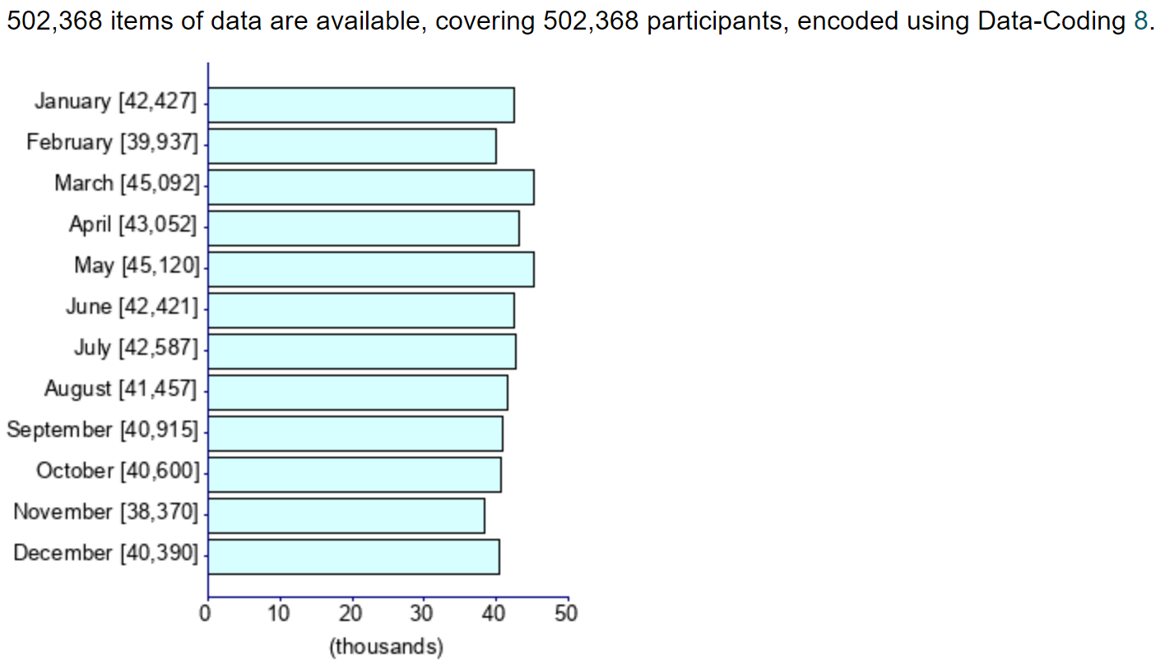
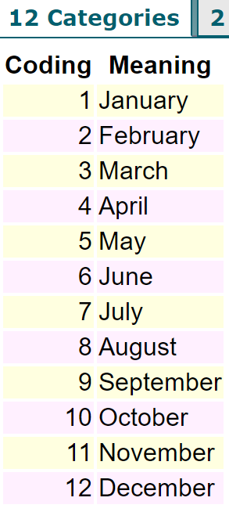
Month of birth

Slide 18
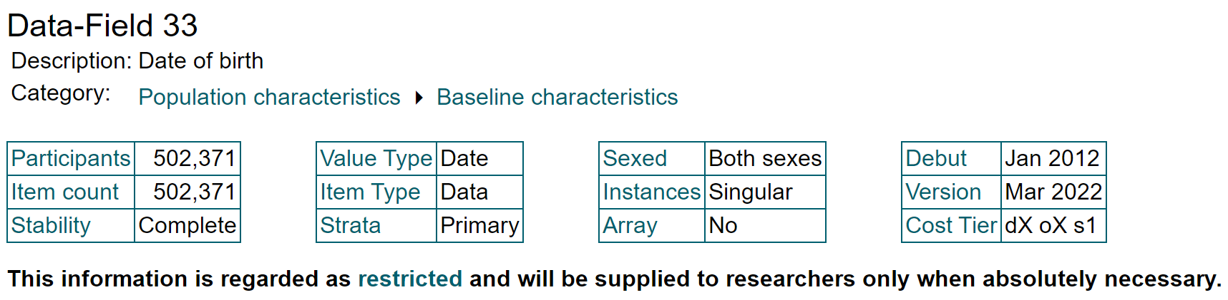
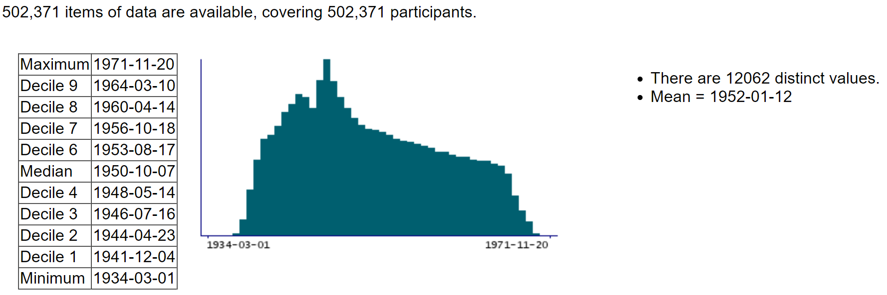
Date of birth

Slide 19
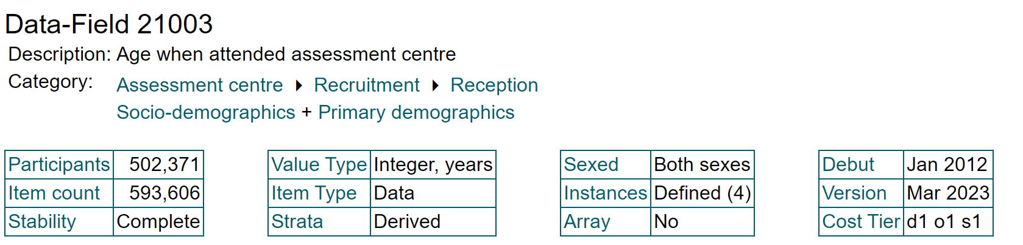
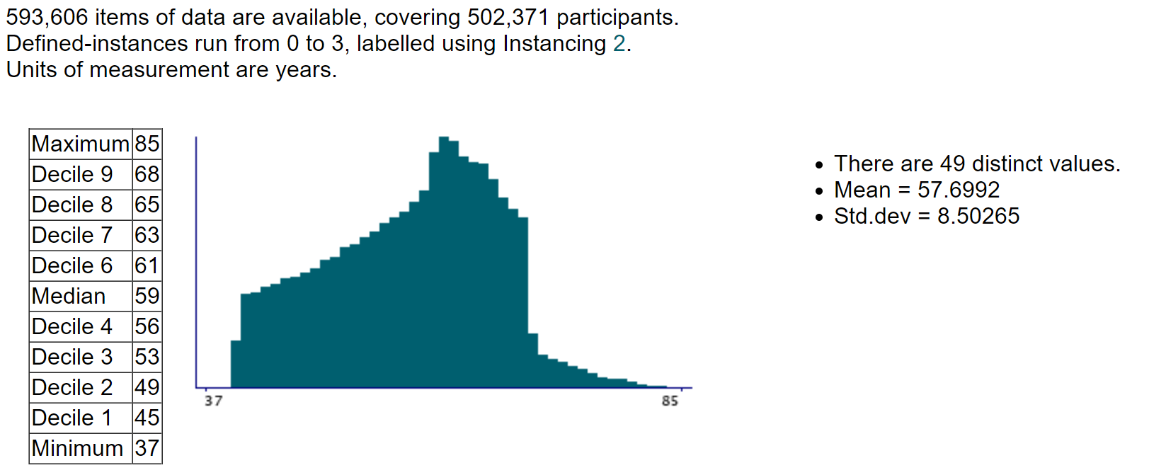
Age when attended assessment centre

Slide 20
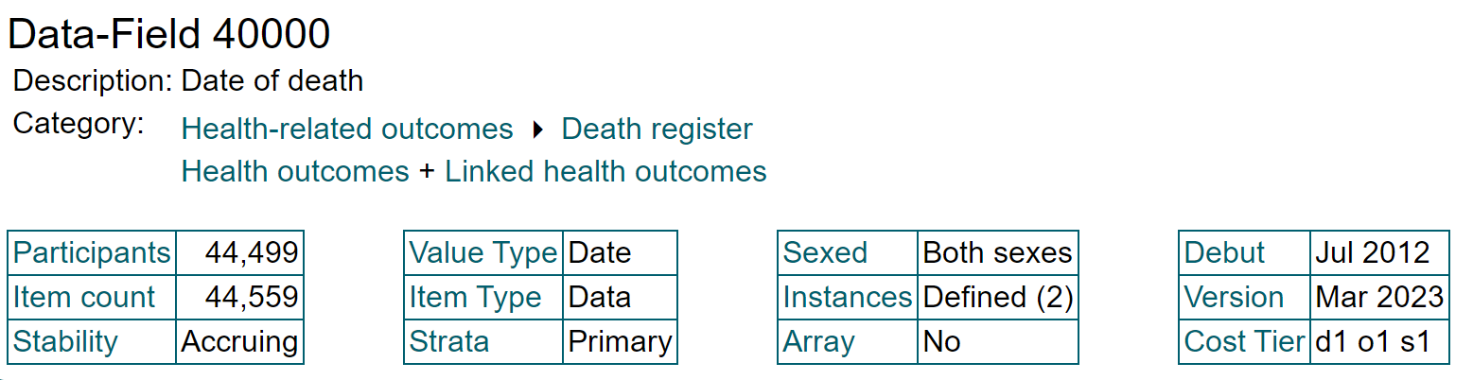
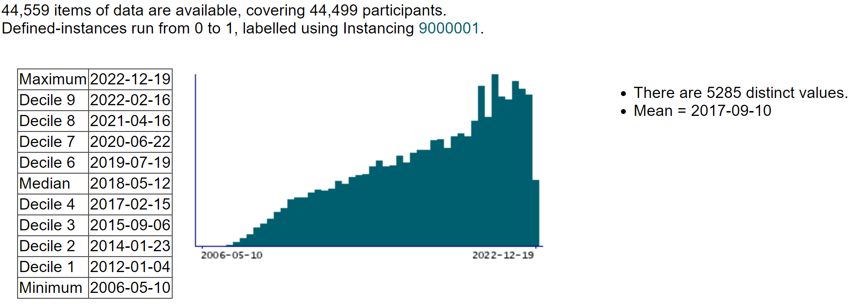
Date of death

Slide 21
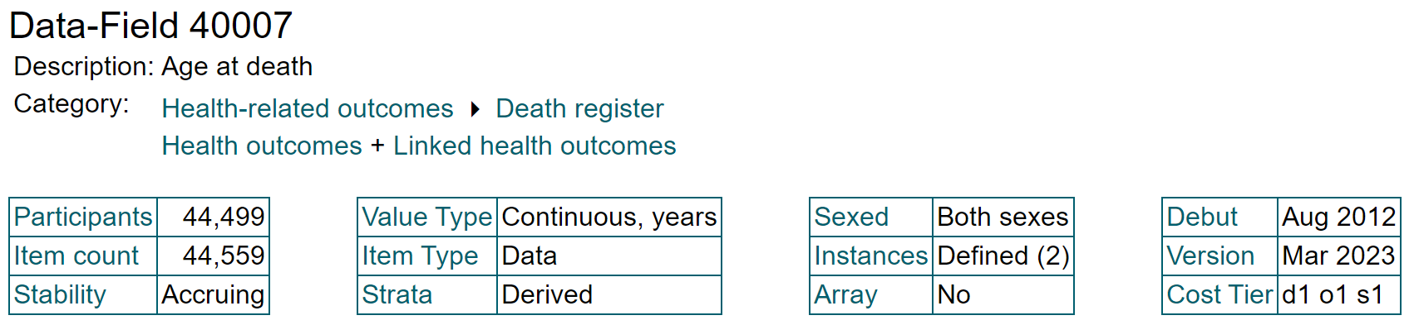
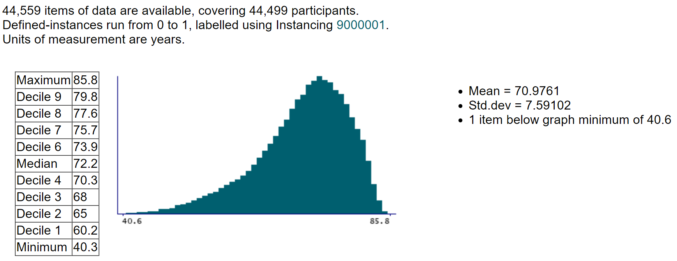
Age at death

Slide 22
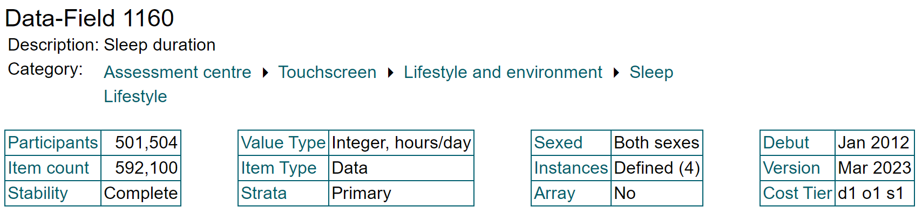
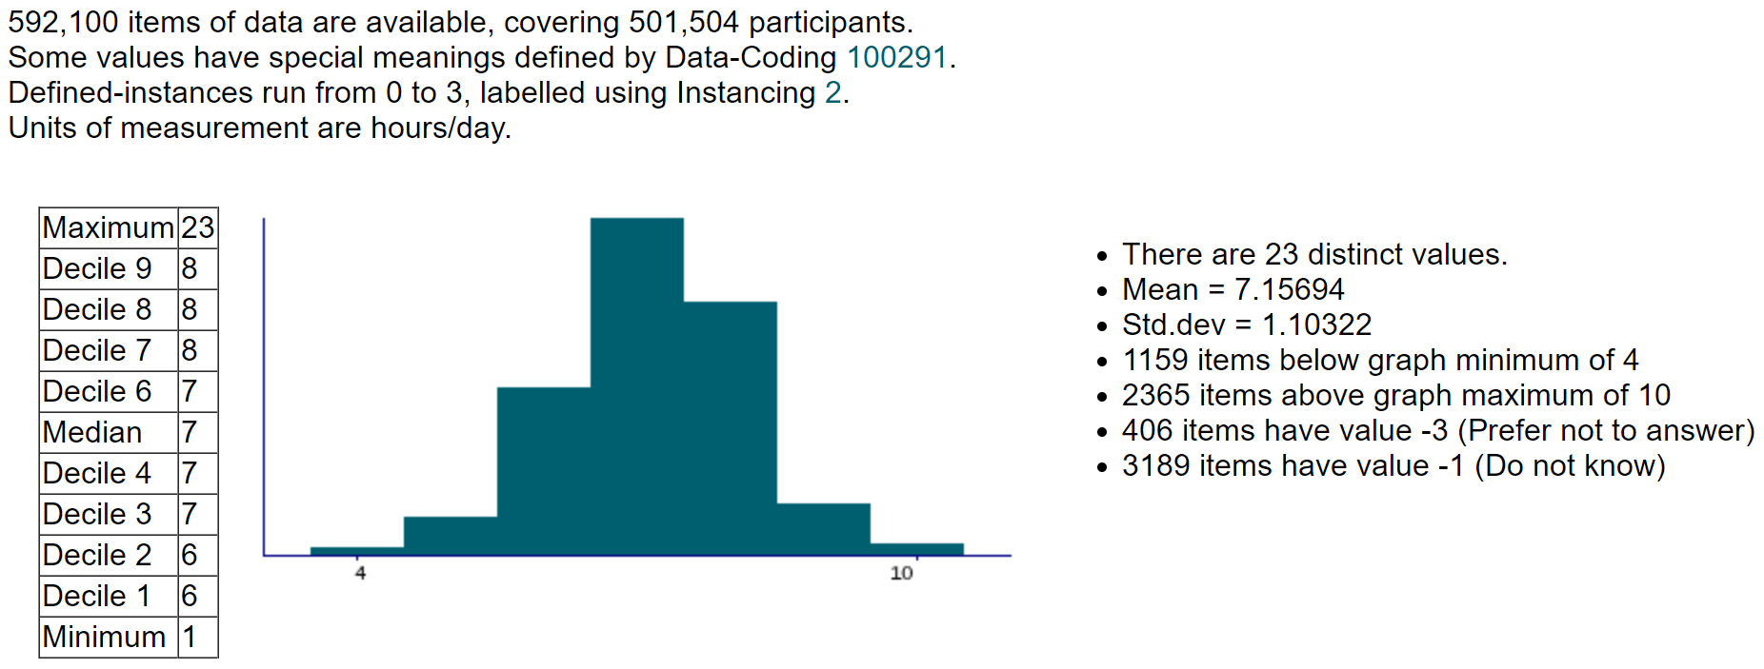
Sleep duration

Slide 23
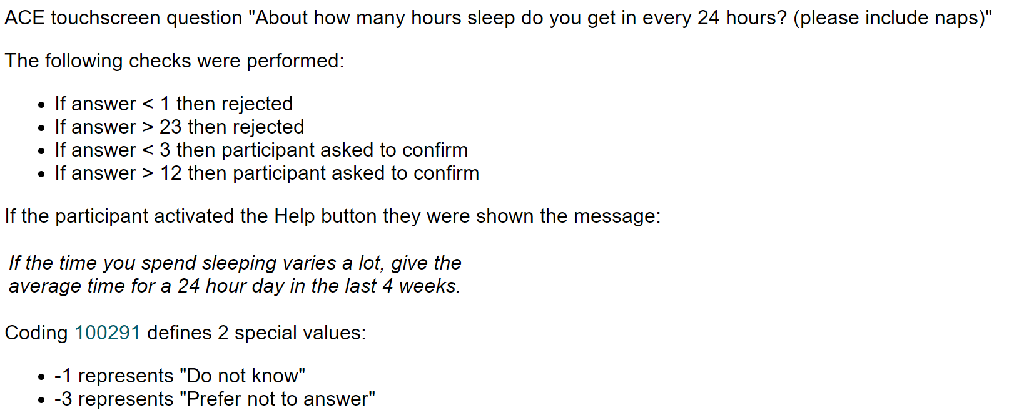
Sleep duration

Slide 24
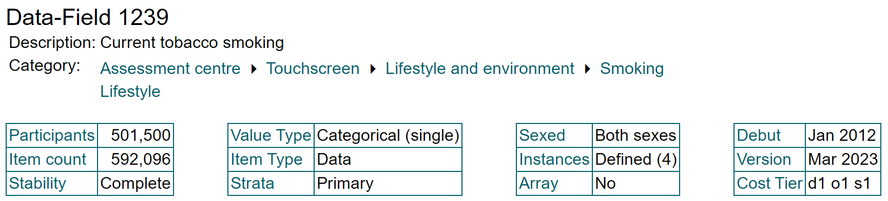
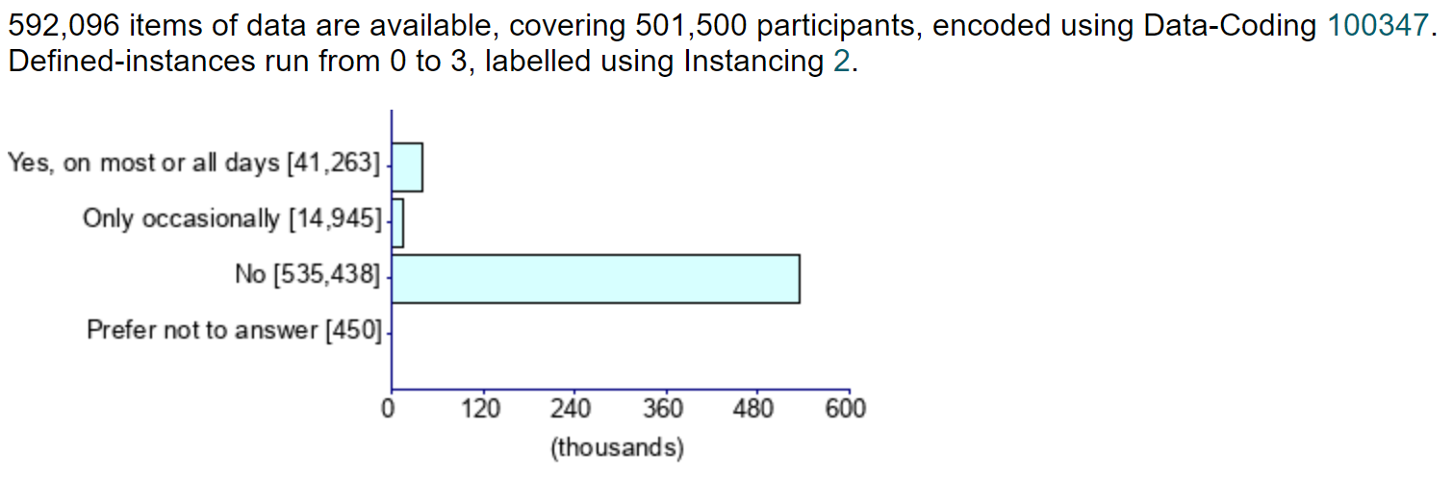
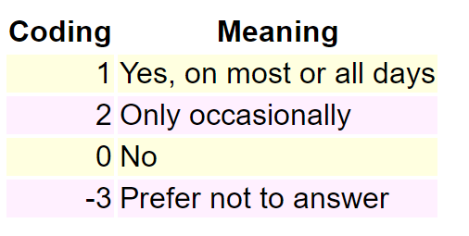
Current tobacco smoking

Slide 25
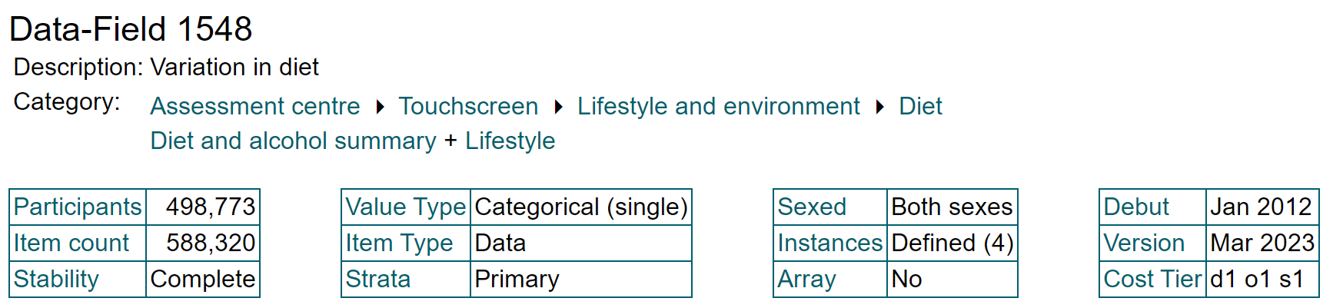
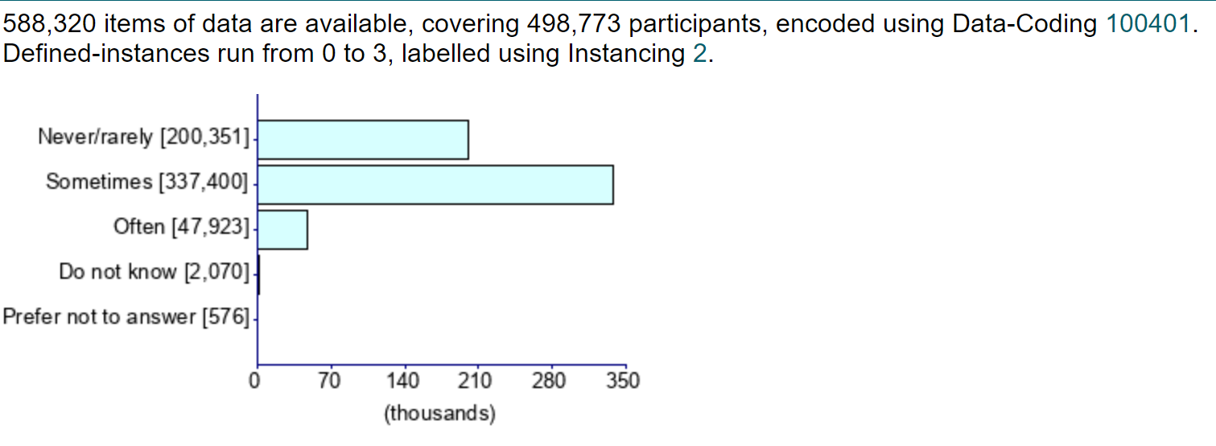
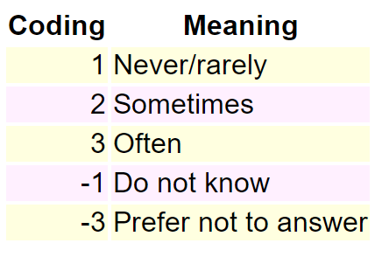
Variation in diet

Slide 26
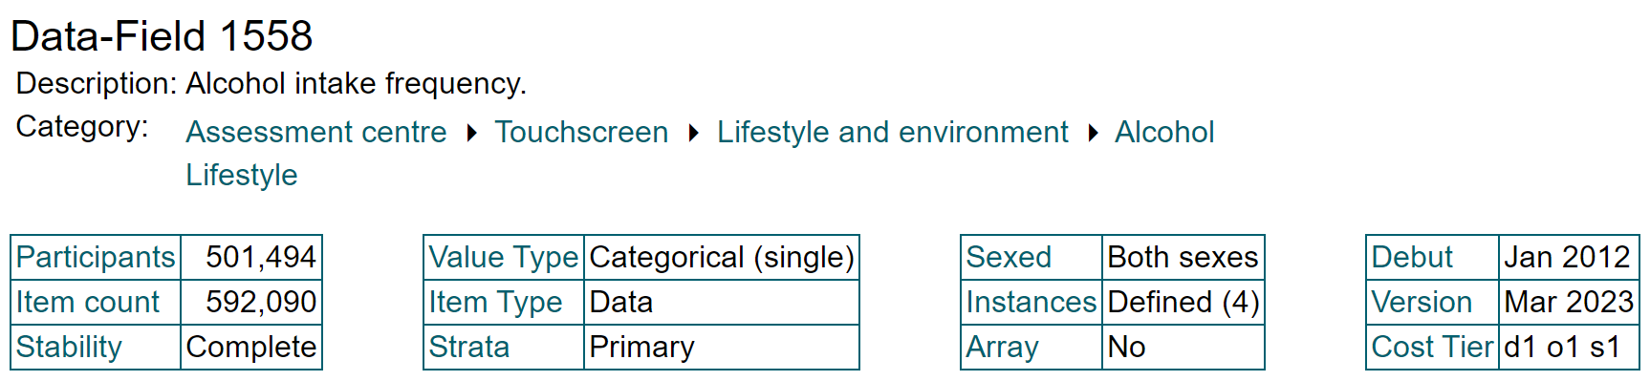
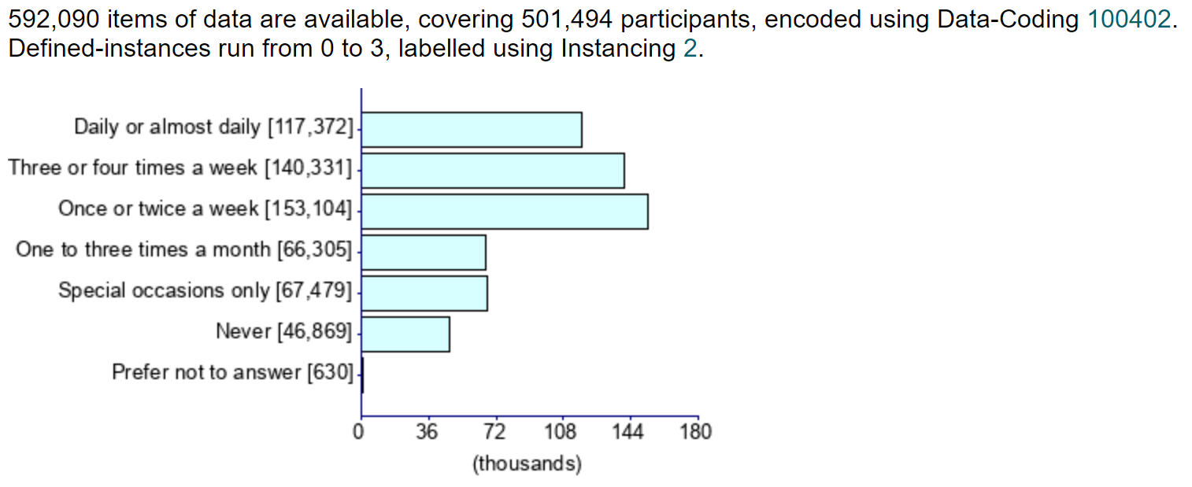
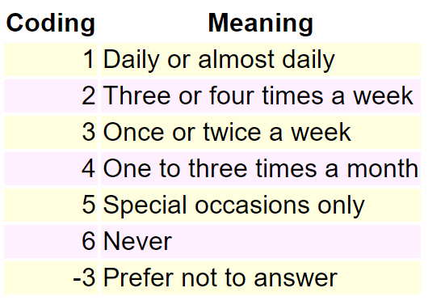
Alcohol intake frequency

Slide 27
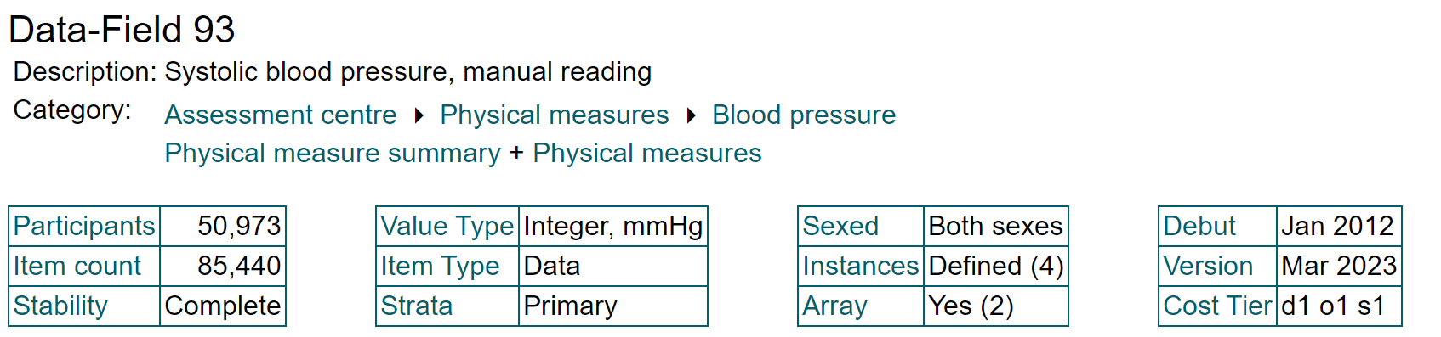
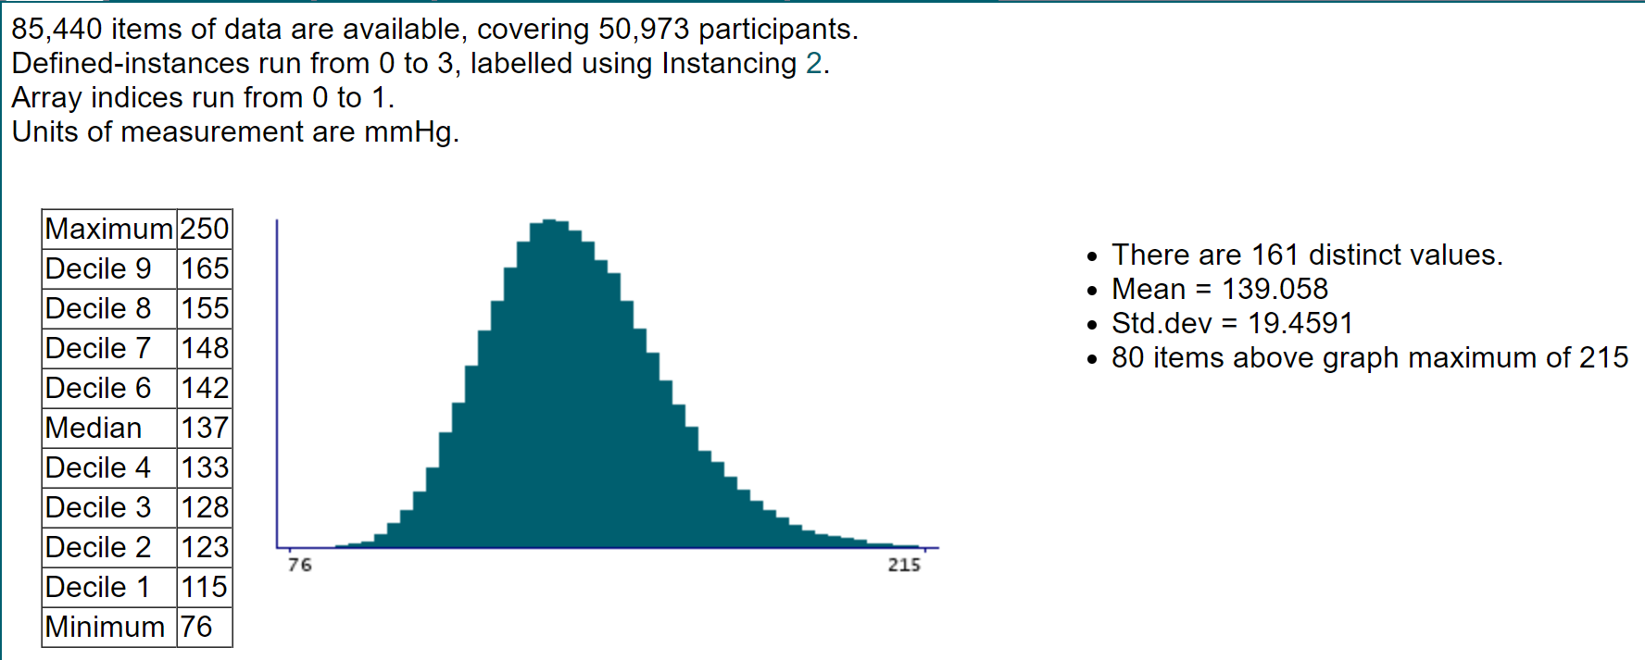
Systolic blood pressure, manual reading

Slide 28
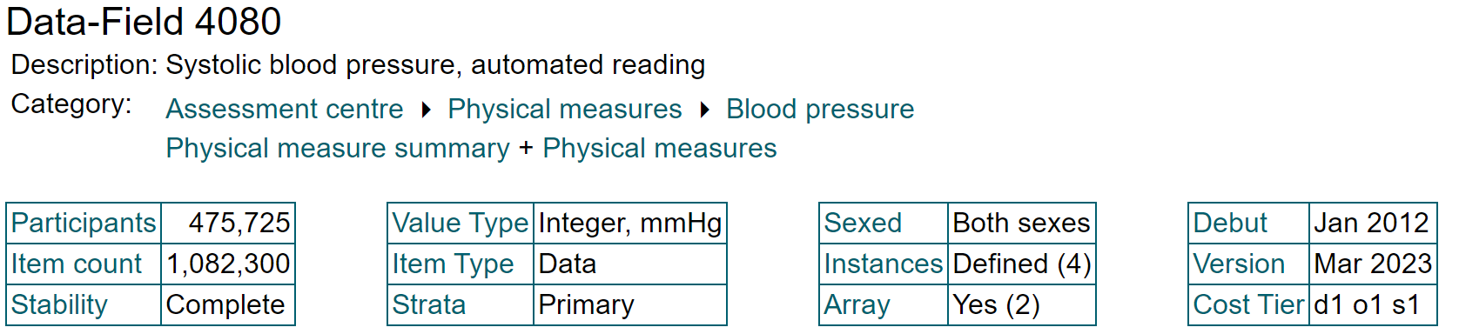
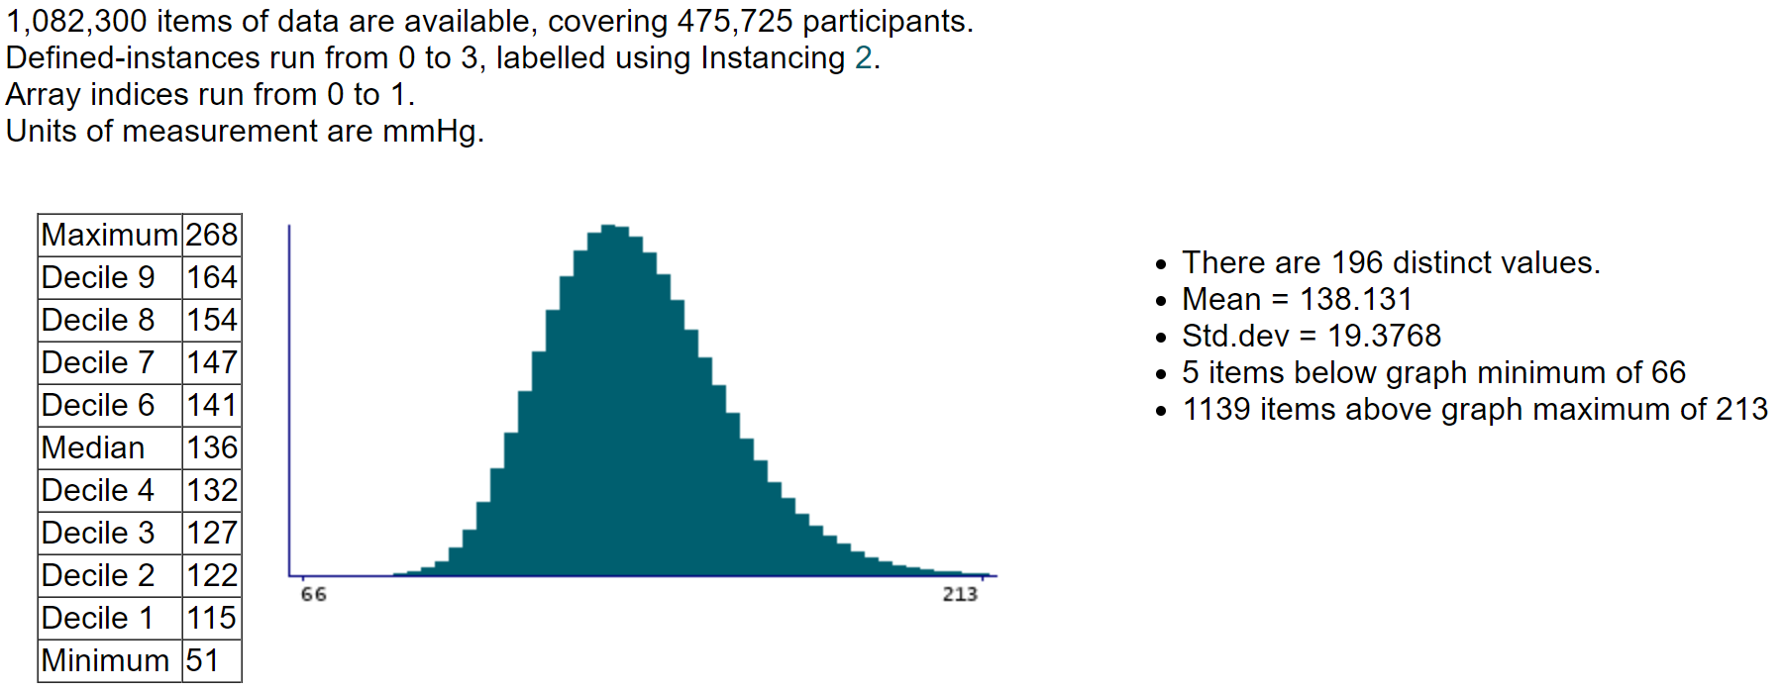
Systolic blood pressure, automated reading

Slide 29
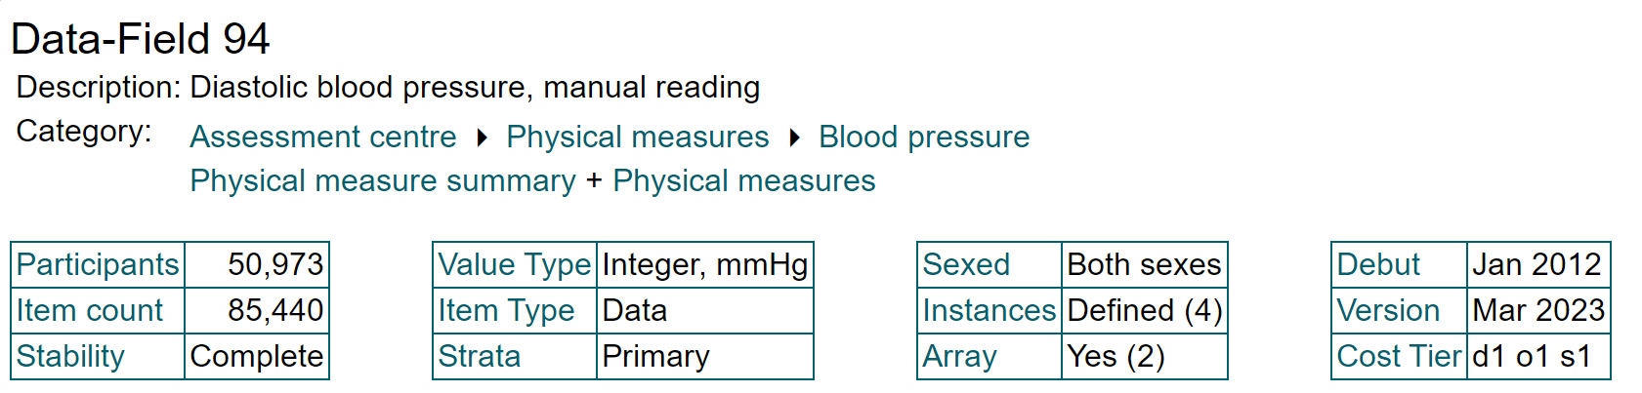
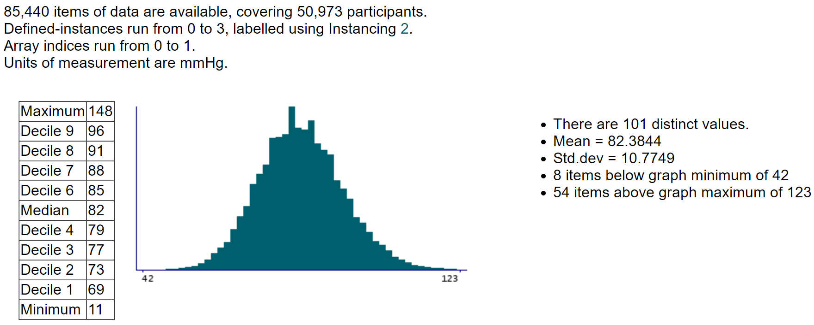
Diastolic blood pressure, manual reading

Slide 30
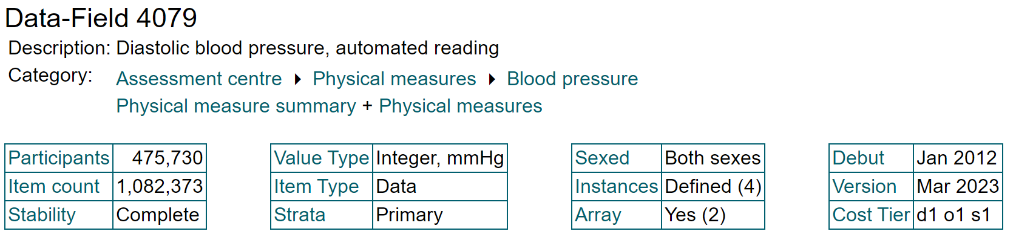
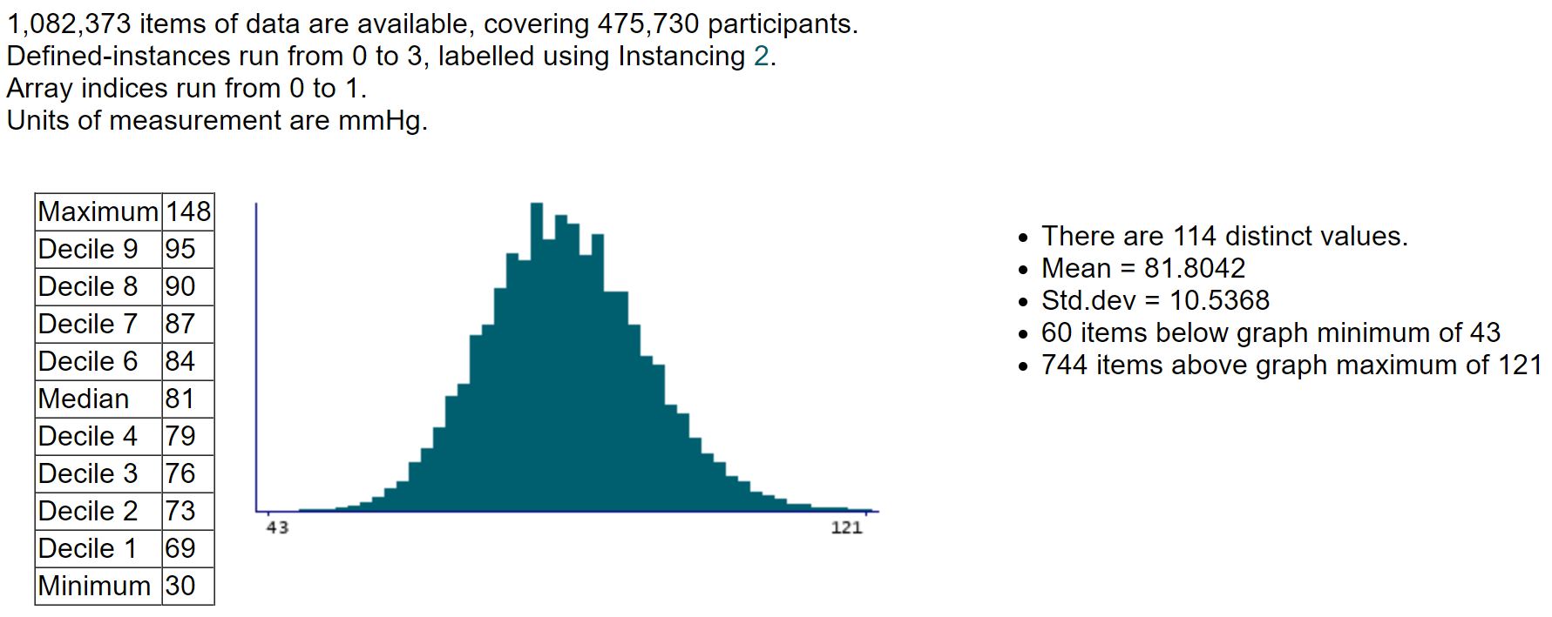
Diastolic blood pressure, automated reading

Slide 31
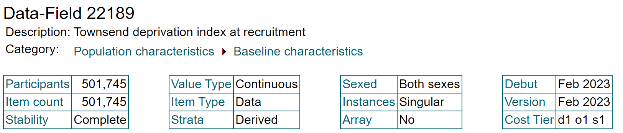
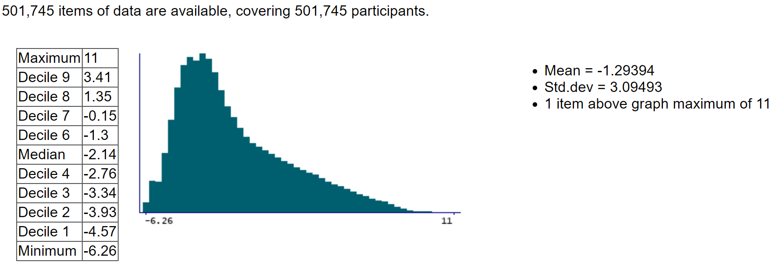
Townsend deprivation index at recruitment

Slide 32



Skin colour

Slide 33



Diabetes diagnosed by doctor

Slide 34



Qualifications

Slide 35



Frequency of strenuous sports in last 4 weeks

Slide 36



Seen doctor (GP) for nerves, anxiety, tension or depression

Slide 37



Wears glasses or contact lenses

Slide 38



Other eye problems

